Slide 1

IDEATHON
CSL2020: DATA STRUCTURES & ALGORITHMS
PROJECT TITLE
SHORTEST PATH ALGORITHMS FOR CAMPUS NAVIGATION
TEAM MEMBERS
INSTRUCTOR
RAHUL GARG(B22CH025)
YOGESH JAJORIA(B22ME073)
DHRUV KUMAR SINGH(B22CH010)
SACHIN CHOUDHARY(B22ME056)
DR. SUCHETANA CHAKRABORTY
MENTORS
DIXIT DUTT BOHRA
SHUBHAM KUMAR

Slide 2

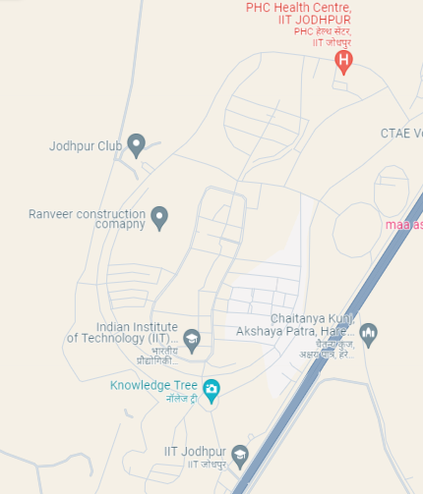
PROBLEM STATEMENT
Finding The Shortest Path For Campus Navigation
Getting around the vast campus of IIT Jodhpur can be confusing and time-consuming for students, faculty, and visitors.
Existing navigation options often don't give the quickest or easiest routes, and they don't consider things like crowded areas or events happening on campus.
To make campus travel easier, we want to create a navigation system using different algorithms like Dijkstra, bellman Ford, A star, etc.
This system will find the shortest and fastest paths between different spots on campus.
Our goal is to simplify campus travel, save time, and make getting around IITJ smoother for everyone.

Slide 3

PROBLEM STATEMENT
USE CASE MAPPING
0
3
0: Main Gate IIT Jodhpur
1: Knowledge Tree
2: Kendriya Bhandar
3: School of AIDE
4: Sports Complex
5: Administrative Block
6: Library
7: Lecture Hall Complex
8: Department of Computer Science
9: Y3 Hostel (Amaltas)
10: Primary Health Centre
11: Department of Mechanical Engineering
12: Shamiyana
13: Jodhpur Club
2
1
4
5
6
9
7
10
8
12
13
11
CAMPUS MAP IITJ

Slide 4
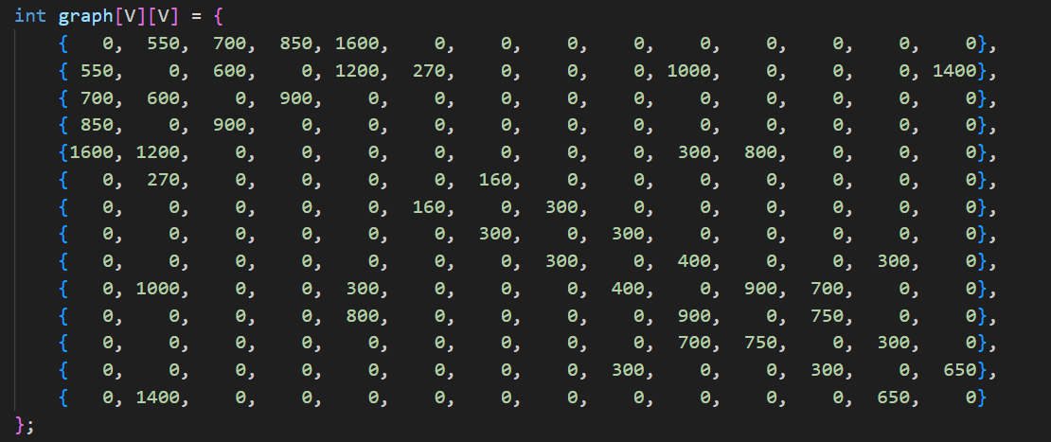
PROBLEM STATEMENT
USE CASE MAPPING
9: Y3 Hostel (Amaltas)
10: Primary Health Centre
11: Department of Mechanical Engineering
12: Shamiyana
13: Jodhpur Club
0: Main Gate IIT Jodhpur
1: Knowledge Tree
2: Kendriya Bhandar
3: School of AIDE
4: Sports Complex
5: Administrative Block
6: Library
7: Lecture Hall Complex
8: Department of Computer Science

Slide 5
PROBLEM STATEMENT
Importance/Relevance:- Inaccurate or inefficient navigation systems can lead to wasted time, frustration, and decreased overall campus experience.
Challenging Nature:-Campus navigation presents unique challenges due to the large and complex layout of the campus, varying levels of pedestrian traffic, dynamic event schedules, and diverse user needs. Traditional navigation methods often fail to address these challenges adequately, resulting in suboptimal routes and user dissatisfaction.
Promise of Data Driven Solutions:-This data-driven approach ensures that navigation decisions are based on up-to-date information, leading to more accurate and responsive navigation experiences for users.

Slide 6
CURRENT STATUS
At present, navigating the campus of IIT Jodhpur relies primarily on traditional methods such as verbal directions, and online maps like Google Maps.
While these tools offer some assistance, they often lack the specific details and real-time updates needed to navigate the campus efficiently.
Additionally, there is a lack of a dedicated campus navigation system that takes into account the unique layout and requirements of IIT Jodhpur.

Slide 7
OUR ALGORITHM
1) A Star Algorithm:-
A* (A-star) algorithm is a heuristic search algorithm used to find the shortest path between a start node and a goal node.
It evaluates nodes by combining the cost of reaching the node from the start node (known as g-value) and the estimated cost of reaching the goal node from the current node (known as h-value).
The algorithm selects nodes with the lowest f-value (sum of g-value and h-value) for expansion, prioritizing nodes that are closer to the goal.
A* guarantees finding the shortest path if certain conditions like admissible heuristic are met.
2) Dijkstra's Algorithm:-
Dijkstra's algorithm is a graph search algorithm used to find the shortest path from a single source node to all other nodes in a weighted graph.
It maintains a priority queue of nodes yet to be processed, with their tentative distances from the source node.
The algorithm iteratively selects the node with the smallest tentative distance and relaxes its outgoing edges, updating the distances of adjacent nodes if shorter paths are found.
Dijkstra's algorithm ensures the shortest path to each node is discovered before terminating, making it ideal for finding shortest paths in a graph without negative edge weights.

Slide 8
OUR ALGORITHM
3) Bellman-Ford Algorithm:-
Bellman-Ford algorithm is a single-source shortest path algorithm that can handle graphs with negative edge weights and detect negative weight cycles.
It maintains an array of tentative distances from the source node to all other nodes, initially set to infinity.
The algorithm relaxes all edges repeatedly for a number of iterations, updating the tentative distances if shorter paths are found.
Bellman-Ford algorithm detects negative weight cycles by performing one extra iteration and checking for further distance updates, which indicate the presence of a cycle.
4) Floyd-Warshall Algorithm:-
Floyd-Warshall algorithm is a dynamic programming approach used to find the shortest paths between all pairs of nodes in a weighted graph.
It constructs a matrix where each entry represents the shortest distance between two nodes.
The algorithm iteratively considers all possible intermediate nodes and updates the shortest path distances if a shorter path is found through the intermediate node.
Floyd-Warshall algorithm is efficient for finding shortest paths in dense graphs or graphs with negative edge weights.

Slide 9
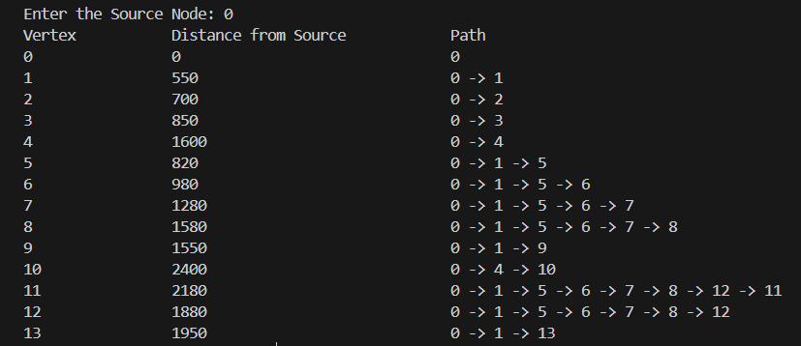
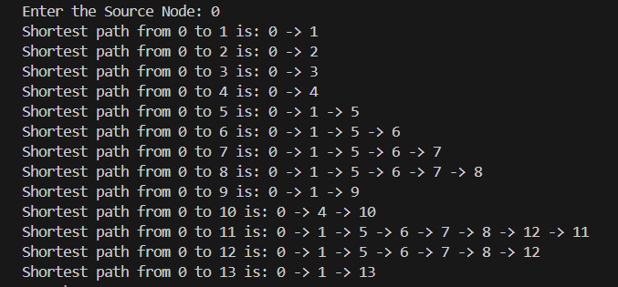
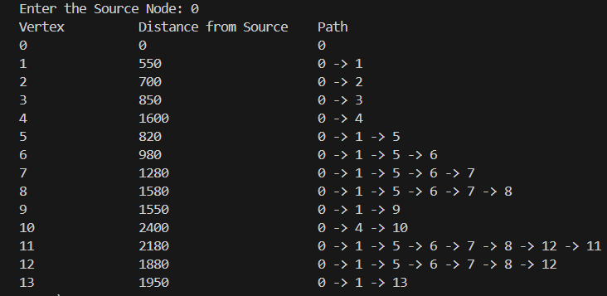
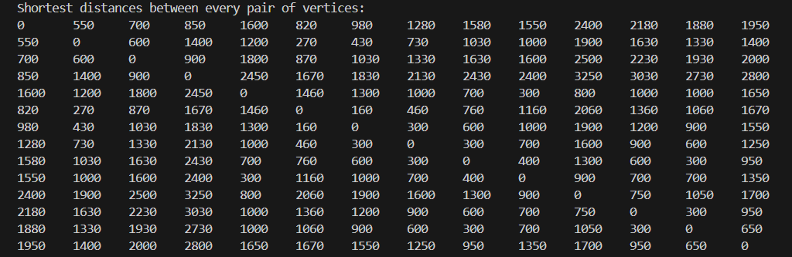
RESULT
1) Dijkstra Algorithm :-
2) A Star Algorithm:-
3) Bellman Ford Algorithm:-
4) Floyd-Warshall Algorithm:-

Slide 10
IDEA
Implemented Idea for Campus Navigation at IIT Jodhpur
In our quest to enhance campus navigation at IIT Jodhpur, we have implemented a comprehensive solution leveraging advanced algorithms such as A* (A-star), Dijkstra, Floyd-Warshall, and Bellman-Ford. Each algorithm serves a specific purpose in calculating the shortest paths and providing node-wise routes across the campus.
A (A-star) Algorithm*: A* is used for finding the shortest path between two nodes (locations) on the campus map. It efficiently combines the advantages of both uniform cost search and greedy best-first search to provide an optimal path while considering factors such as distance, estimated cost, and heuristic information.
Dijkstra Algorithm: Dijkstra's algorithm is employed to calculate the shortest paths from a single source node (starting point) to all other nodes on the campus map. It systematically explores the neighboring nodes, updating their shortest distance from the source node until all nodes have been visited, thereby determining the optimal routes.
Floyd-Warshall Algorithm: The Floyd-Warshall algorithm is utilized to calculate the shortest paths between all pairs of nodes on the campus map. This algorithm efficiently handles scenarios where users may need to find the shortest route between any two locations without specifying a single source or destination.
Bellman-Ford Algorithm: Bellman-Ford algorithm is employed to handle scenarios involving negative edge weights or cycles within the campus map graph. It is particularly useful for detecting and resolving negative-weight cycles that may arise in certain pathfinding scenarios.

Slide 11
CONCLUSION
Enhanced Campus Navigation Solution:-
Through the implementation of advanced algorithms such as A* (A-star), Dijkstra, Floyd-Warshall, and Bellman-Ford, our campus navigation solution at IIT Jodhpur has achieved significant milestones in enhancing the navigation experience for students, faculty, and visitors.
By harnessing the power of these algorithms, we have successfully addressed the challenges associated with finding the shortest distances and optimal routes across the sprawling campus. Users can now access a robust system that not only calculates the shortest paths between specific locations but also provides comprehensive node-wise routes, ensuring efficient traversal from one point to another.
Moreover, our solution considers various factors such as distance, estimated cost, heuristic information, and real-time constraints like pedestrian traffic and building accessibility. This holistic approach enables users to make informed decisions about their routes, saving time and effort while navigating the campus.

Slide 12
CONTRIBUTION
Contribution of Team Members:-
1) Rahul Garg(B22CH025) :- Contributed in writing the A star algorithm and making the presentation of the project .
2) Yogesh Jajoria(B22ME073):- Contributed in writing the Dijkstra algorithm and making the presentation of the project.
3) Sachin Choudhary(B22ME056):- Contributed in writing the code of Bellman Ford Algorithm in this project .
4) Dhruv Kumar Singh(B22CH010):- Contributed in writing the code of Floyd Warshall algorithm in this project.

Slide 13
THANK YOU

